Slide 1
IOT VIRTUAL DOCTOR ROBOT WITH OXYGEN LEVEL DETECTOR
Under guidance of
Mr Naveen R,
Department of Aeronautical Engineering,
BIT,
Sathy.
1.2021UIT1047 & SHASHTHIGA R
2.2021USE1036 & FAROOQ AHAMED S

Slide 2
Abstract
This project investigates the potential of Health care which is the aim of the Home Health Care Systems in near future. Doctors are usually needed to work at every hospital and emergency centre every now and then. But it is not feasible for every doctor to be available at every place at desired time.
The problem with video calling is that video calls need to be done from a PC or laptop on a desk. This limits the doctors capacity to view patient or around operation theatre at will or even move through hospital rooms as needed.
To help solve this issue we here develop a virtual doctor robot that allows a doctor to virtually move around at a remote location at will and even talk to people at remote location as desired and person’s oxygen level will be monitored for every 10 minutes.

Slide 3
Problem Statement Addressed
Health support of each individual should be considered as very important in today's world because of a rise in many health problems. If there is an increase in the number of patients, then this leads to a decrease in the relative number of doctors. As a result, the diagnostics are delayed or some patients are ignored. This makes patients more dependent on doctors for their check-up.
Keeping all these issues in mind, healthcare systems have started connecting with IoT for maintaining the digital identity of each and every patient. Due to non availability of doctors/caregivers and not being able to access the healthcare systems, many health problems are getting undetected in the healthcare system. On the other hand, these IoT based healthcare systems have helped the patients and doctors to continuously monitor and easily analyze the patient data.
To avoid this problem, IoT has ensured the personalization of infant healthcare by maintaining the digital identity of infants each and every moment. By making use of IoT smart sensors, the infant health can be monitored, data can be collected, and realtime information of the infants each and every moment can be sent to their parents.

Slide 4
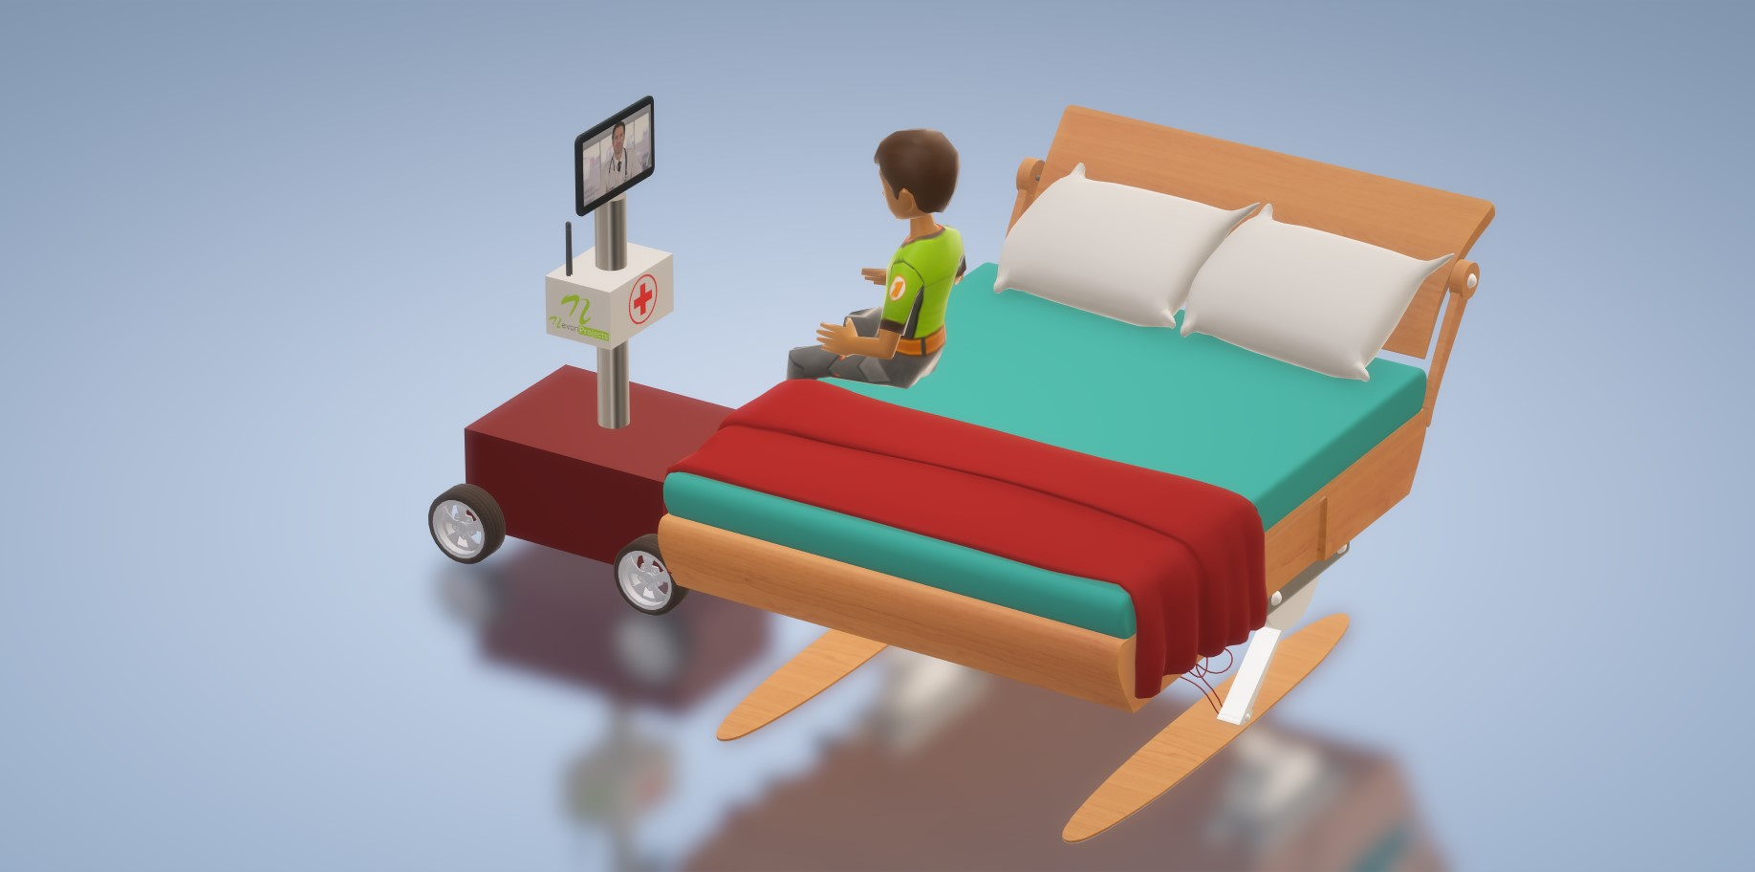
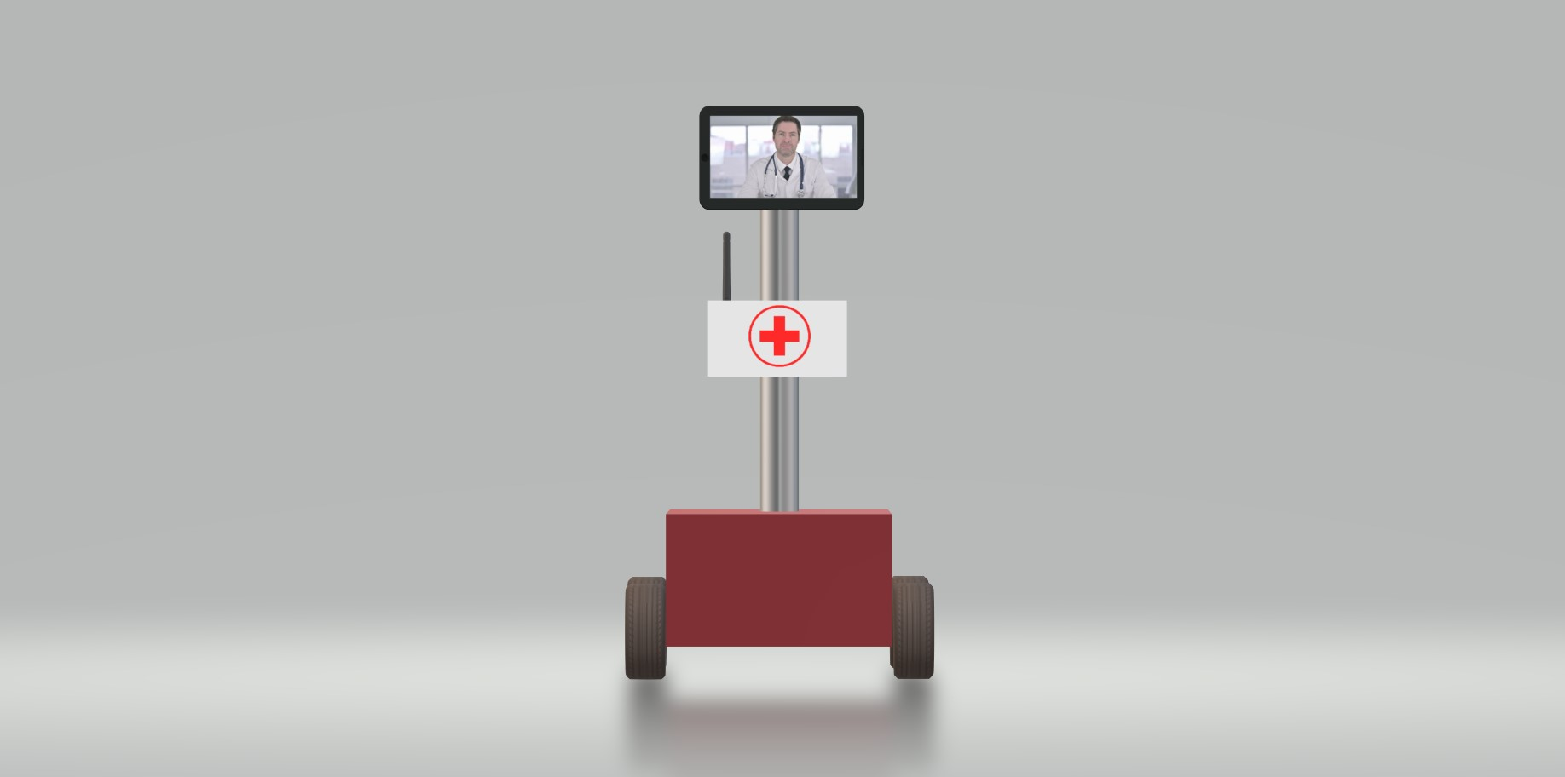
Existing Solution to the Problem Addressed
The system makes use of a robotic vehicle with 4 wheel drive for easy navigation. The robot also includes a controller box for circuitry and a mounting to hold a mobile phone or tablet. The mobile or tablet is used to hold live video calls.
The doctor can use an IOT based panel to control the robot. The control commands sent sent online are received by the robot controller. The robot controller operates over wifi internet. The received commands are received in real time and the robot motors are operated to achieve the desired movement commands. Also the root has other functions including battery status alert to remind of battery charging on time.

Slide 5
Proposed Solution to the Problem Addressed
This system uses an additional instrument i.e) pulse oximeter to detect the person’s oxygen level for every 10-15 mins. When the patient’s health becomes critical if the oxygen level gets ( >93% ) automatically it calls to the consult nearby doctor and shows the person’s face through the virtual monitor as he could speak to the consult doctor about his health problem.
Pulse oximetry is a test used to measure the oxygen level(oxygen saturation) of the blood. It is easy, painless measure of how well oxygen being sent to parts of your body further from your heart,such as arms and legs.

Slide 6
Project Work Plan
How the system works
The system only works when a person is in front of the device. The ultrasonic distance-measurement sensor (HC SR-04) senses the change in the distance around the device (because of the patient in front of it).
The device then asks for the details programmed on the screen. For example, it asks the patient to open their mouth and their eyes, and takes photos using the camera module, saving the images locally.
The device also requests the patient’s ID.
After all of the data is documented, it emails the registered doctor with the attached images, using the “multipart content type.” This is a type of data that specifies that the email contains media content.
This email is sent using the SMTP protocol. The physician downloads the email using the standard, Internet message access protocol (IMAP).
The physician examines the information and images and contacts the patient and pulse level will be monitored for every 10-15 mins till he gets disconnected with the device.

Slide 7
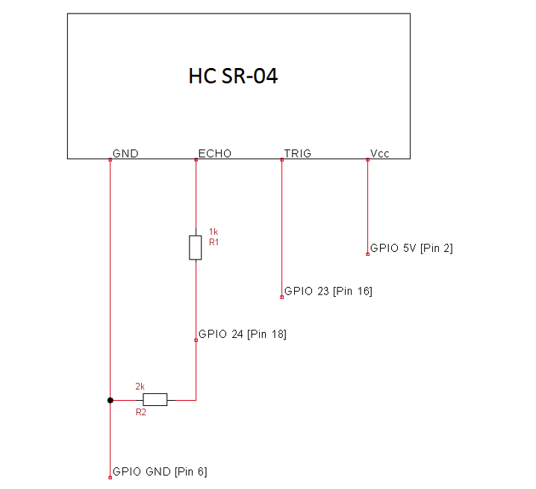
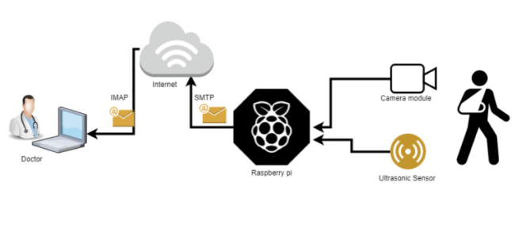
Block Diagram Circuit Diagram
b

Slide 8
Flow Chart
START
SENSOR INITIALIZATION
CHECK THE PATIENTS HEALTH PARAMETERS
PULSE RATE
HEART SOUND
BLOOD PRESSURE
DISPLAYED ON THE MONITOR AND SENT TO THE SERVER
DOCTOR ACCESS TO THE SERVER(CLOUD) THROUGH THE IP ADDRESS
PATIENT AND THE CARE TEKER ACCESS TO THE SERVER (CLOUD) THROUGH THE IP ADDRESS
ALARM
CALL DOCTOR
STOP

Slide 9
Effective utilization of the Modern Tool & Cloud
A.Implementation Platform
The details of implementation platform is RPI supports many Linux distribution viz Raspbian,Debian based distribution. The programming language sup-ported by Raspberry pi are Python, c/c++ and java.
B.Working of IOT cloud healthcare model
Whenever a significant amount of patient’s health-related information is acquired using monitoring node. The IoT-Cloud essentially facilitates convenient way to store data into local database and process it by deploying suitable edge server and virtualization technique.
The interconnection among components involved in IoT- cloud driven healthcare scenario are the three main component of the model are:
(1) The Raspberry pi which is the edge device act as the gateway between the sensor node and the internet and discovers potential patient’s fall by comparing the standard optimal values with the sensed value.
(2)The 6LoWPAN node, which is in charge of reading and delivering to the IoT smart Gateway data retrieved from the multi-sensor board equipped with different medical sensors.
(3) Docker container, which is a virtualization technology to run an application in the isolated environment.

Slide 10
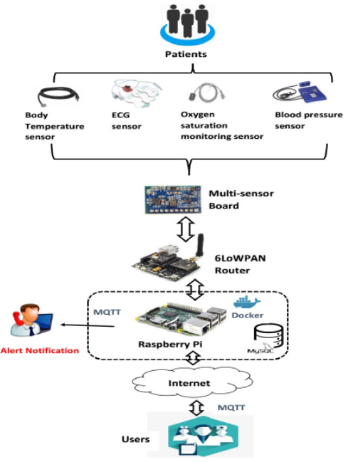
Technology stack Use case
Home
Public areas such as government protected area - park, theatres, zoo, etc
Buses
Telemedicine
Robotics/artificial intelligence

Slide 11
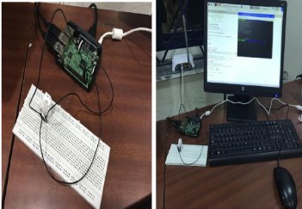
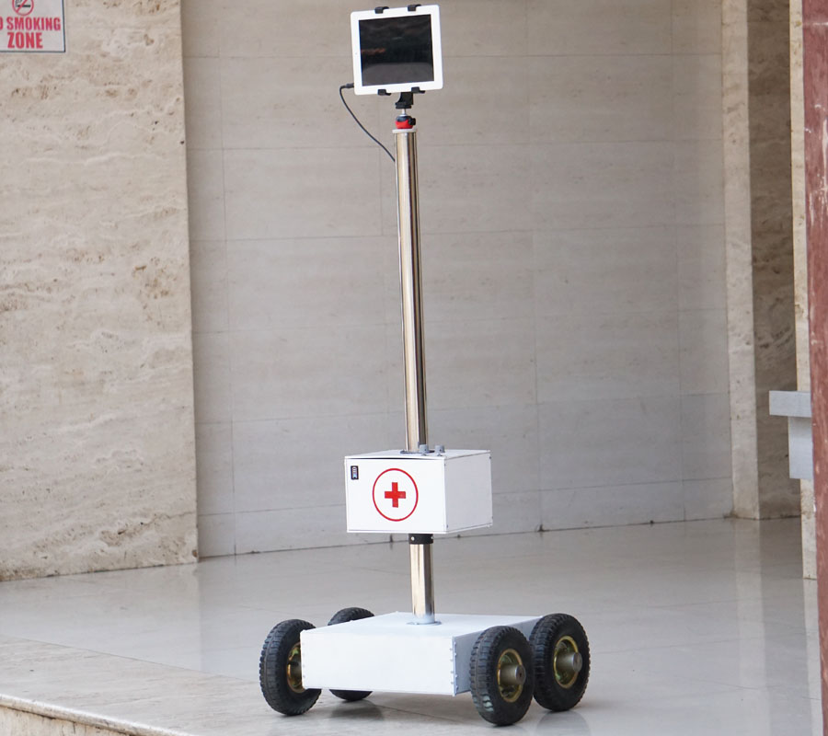
Prototype & Sample Output

Slide 12
Analysis of Results & Discussions
Advantages of IoT in Healthcare
• Treatment for diseases are done before they get out of hand, because the patients are continuously monitored and the caregivers or providers can access the real-time data and improve the disease management
• The automated data and the smart monitoring which are controlled by the devices connected with the IoT and the decisions are made easily based on deep analytics which reduces errors.
• Patient monitoring is done on a real-time basis, which significantly cuts down the unnecessary doctor visits and also cuts down the hospital stays. This can reduce the cost for patients
• Connected healthcare enables the caregivers to get access to real-time information when the patient is continuously monitored and the decisions are taken properly. This can help and provide timely care that improves the treatment outcomes.
Disadvantages of IoT in Healthcare
• There is a compatibility problem for the IoT in healthcare, because currently there is no standard for tagging and monitoring with the sensors.
• Privacy and security is one of the big issue with IoT in healthcare, i.e., all the patientdoctor data must be encrypted.
• The software can be hacked by other users and the personal information is misused. These possibilities are endless in IoT.

Slide 13
Cost Benefit Analysis (List of Components / Service Used)
(Budget)
S.No | Component Name | Specification (IC number or Range or Value) | Unit Cost | Total Cost
1. | Raspberry pi | Pi 3 A+: Broadcom BCM2837B0 Pi 4 B: Broadcom BCM2711B0 Zero W: Broadcom BCM2835 CM 3+: Broadcom BCM2837B0 | 740 | 1480
2. | Picamera(Rpi camera) | 38 x 38 x 18.4mm (excluding lens) | 290 | 290
3. | Ultrasonic distance measuring sensor | HC-SR04 | 259 | 1036
4. | Resistors | ±1% 35W - PWR263S-35-10R0F | 374 | 1122

Slide 14
Working video Link
https://www.engineersgarage.com/wp-content/uploads/2021/08/Video.mp4?_=1

Slide 15
References
K. R. Darshan and K. R. Anandakumar, "A Comprehensive Review on Usage of Internet of Things (IoT) in Healthcare System,"International Conference on Emerging Research in Electronics, Computer Science and Technology (ICERECT), Mandya, India, 2015, pp. 132-136, pp. 374–380.
IoT can support potentially life saving applications within the healthcare industry by collecting real-time data. Today many healthcare devices started connecting with “Internet of Things” [Online] https://www.secureidnews.com/wpcontent/uploads/2015/01/MadsenIoT.png. [Accessed: 05-05-2017].

